Slide 1

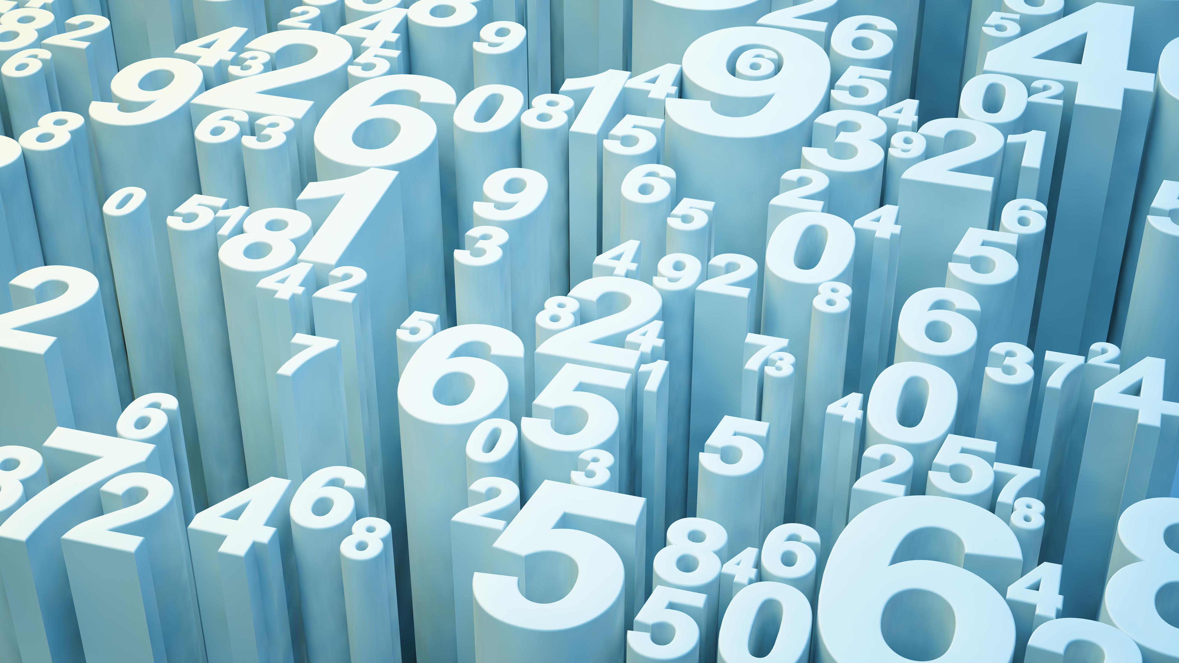
Python and Matplotlib

Slide 2
Matplotlib
A comprehension library for creating static, animated and interactive visualizations in Python.
Makes easy things easier and hard things possible.
Create publication quality plots
Make interactive figures that can zoom, pan and update.
Customize visual style and layout
Export to many file formats
Embed in JupyterLab and Graphical User Interfaces
Use a rich array of third-party packages built on it.

Slide 3
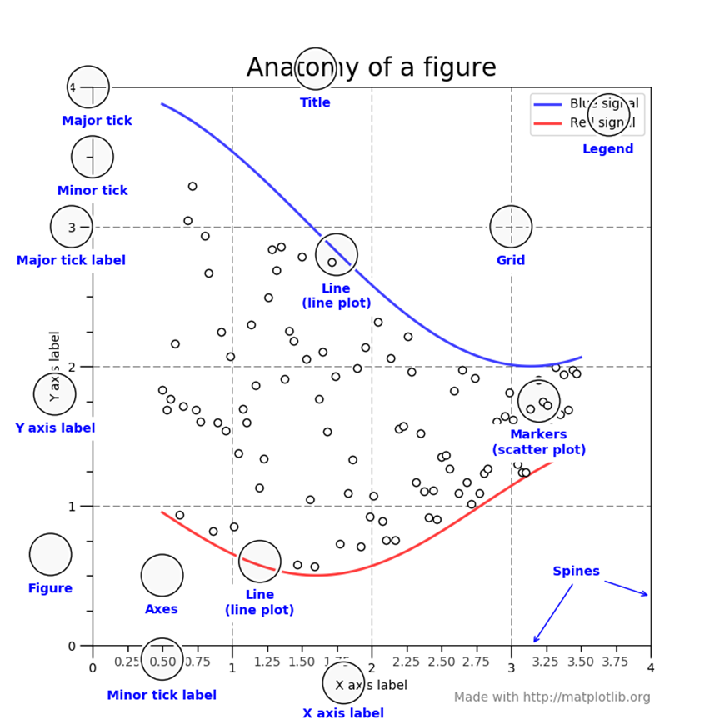

Slide 4
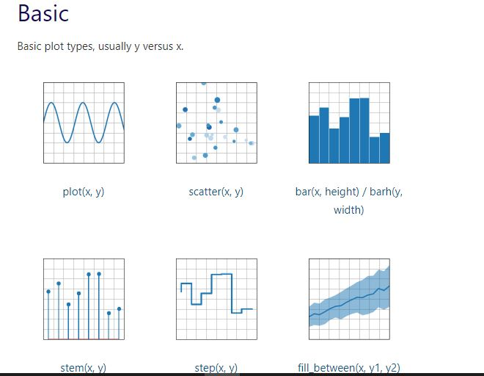
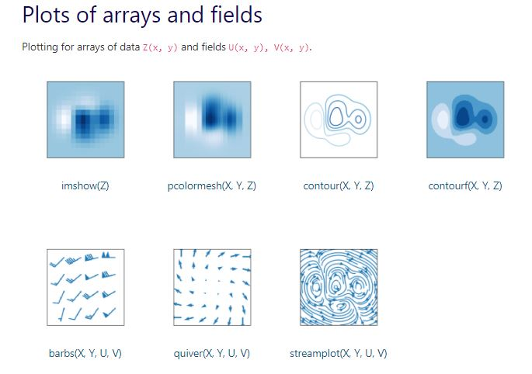
Types of Visuals

Slide 5
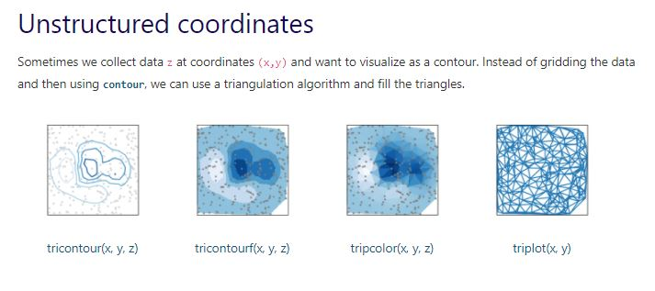
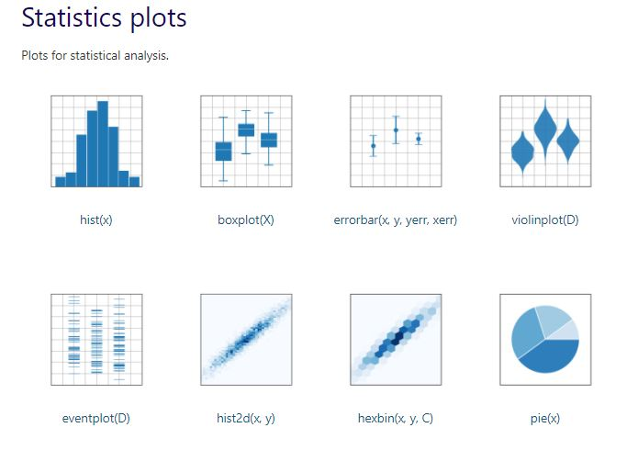

Slide 6
ALSO – pip install jupyter notebook
You need to install it
You need to import it
In your terminal, type
pip install matplotlib
import matplotlib.pyplot as plt
import numpy as np

Slide 7
Open VSCode make sure you are in the right directory initialize jupyter notebook

Slide 8
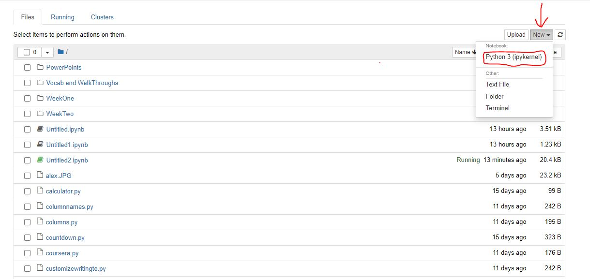
How to start the Jupyter Notebook Server
Type in jupyter notebook in your terminal and press enter

Slide 9
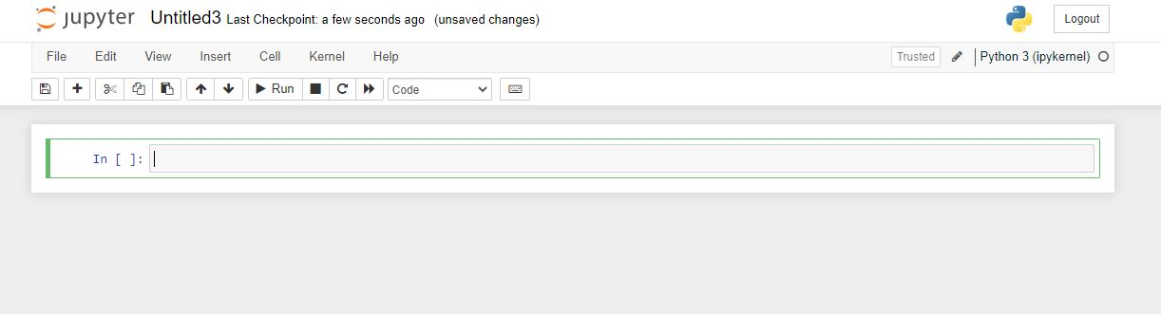
To execute commands click the RUN icon

Slide 10
Draw a line in a diagram from position (1, 3) to position (8,10)
import matplotlib.pyplot as plt
import numpy as np
xpoints = np.array([1, 8])
ypoints = np.array([3,10])
plt.plot(xpoints, ypoints)
plt.show()

Slide 11
Draw 2 points in a diagram from position (1, 3) to position (8,10)
import matplotlib.pyplot as plt
import numpy as np
xpoints = np.array([1, 8])
ypoints = np.array([3,10])
plt.plot(xpoints, ypoints, ‘o’)
plt.show()

Slide 12
Draw a line in a diagram from position (1, 3) to (2, 8) then to (6, 1) and finally to position (8,10)
import matplotlib.pyplot as plt
import numpy as np
xpoints = np.array([1, 8])
ypoints = np.array([3,10])
plt.plot(xpoints, ypoints, ‘o’)
plt.show()

Slide 13
Example One your first graph
import matplotlib.pyplot as plt
x = [1,2,3] # x axis values
y = [2,4,1] # corresponding y axis values
plt.plot(x, y) # plotting the points
plt.xlabel('x - axis’) # naming the x axis
plt.ylabel('y - axis’) # naming the y axis
plt.title('My first graph!’) # giving a title to my graph
plt.show() # function to show the plot

Slide 14
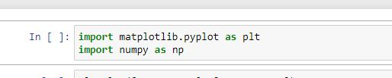
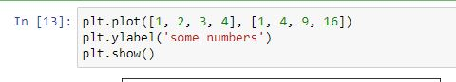
Example Two

Slide 15
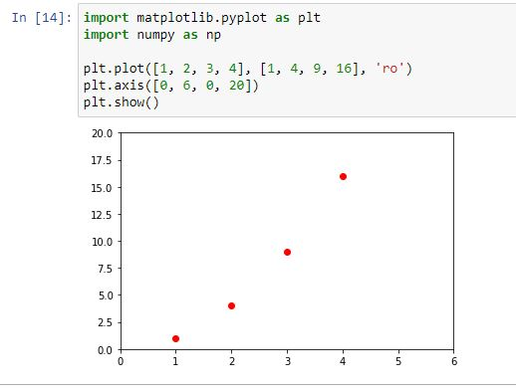
Example Three

Slide 16
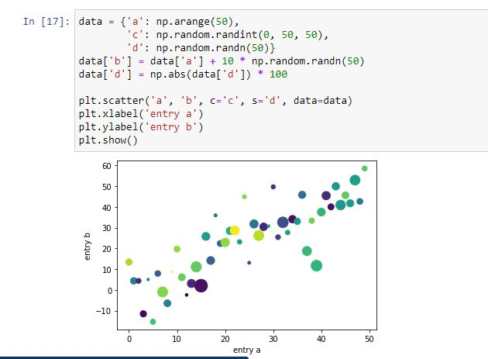
Example Four

Slide 17
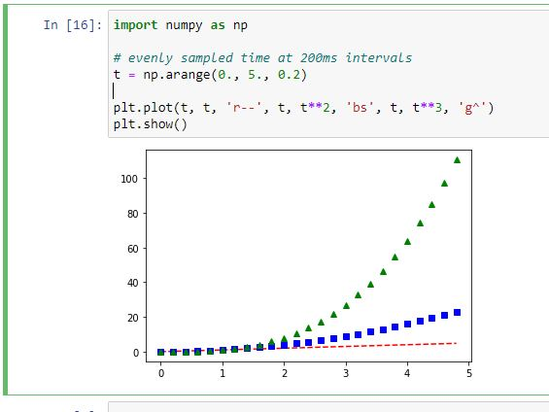
Example Five

Slide 18
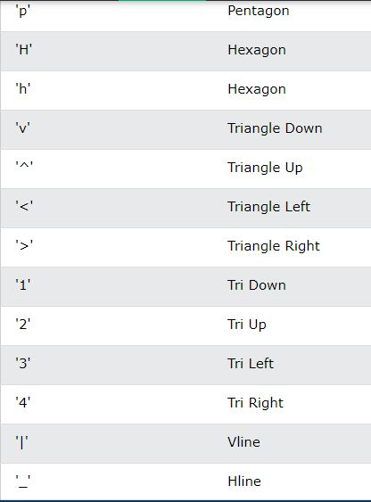
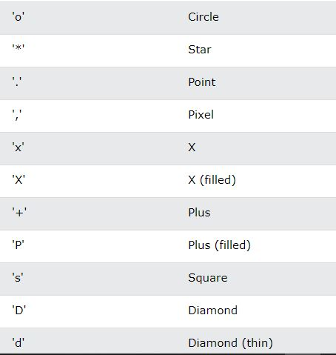
Customize – Customize - Customize

Slide 19
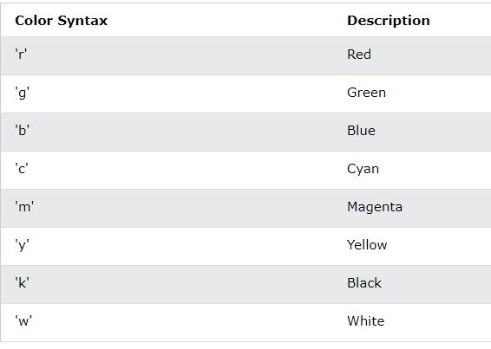

Slide 20
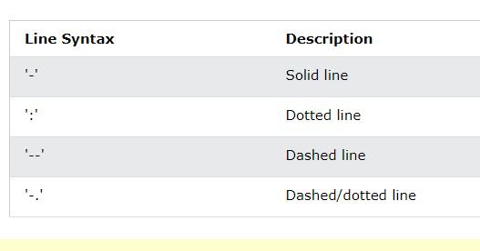

Slide 21
ms = markersize
mec = marker edge color
mfc = marker face color

Slide 22
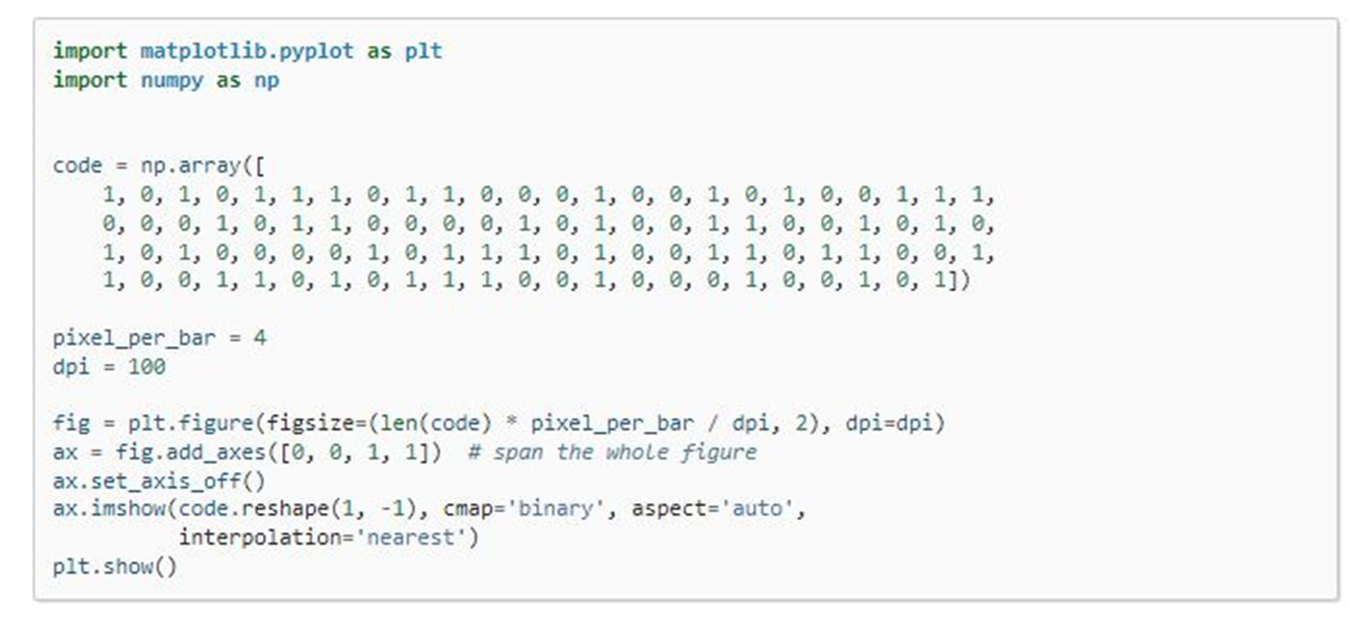
Example Six

Slide 23
Example Seven
import matplotlib.pyplot as plt
a = [1, 2, 3, 4, 5]
b = [0, 0.6, 0.2, 15, 10, 8, 16, 21]
plt.plot(a)
plt.plot(b, "or") # o is for circles and r is for red
plt.plot(list(range(0, 22, 3)))
plt.xlabel('Day ->’) # naming the x-axis
plt.ylabel('Temp ->’) # naming the y-axis

Slide 24
c = [4, 2, 6, 8, 3, 20, 13, 15]
plt.plot(c, label = '4th Rep')
ax = plt.gca() # get current axes command
# set command over the individual boundary line of the graph body
ax.spines['right'].set_visible(False)
ax.spines['top'].set_visible(False)
# set the range or the bounds of the left boundary line to fixed range
ax.spines['left'].set_bounds(-3, 40)
# set the interval by which the x-axis set the marks
plt.xticks(list(range(-3, 10)))
Example Seven
continued

Slide 25
# set the intervals by which y-axis set the marks
plt.yticks(list(range(-3, 20, 3)))
# legend denotes what color signifies what
ax.legend(['1st Rep', '2nd Rep', '3rd Rep', '4th Rep'])
# annotate command helps to write ON THE GRAPH any text
# xy denotes the position on the graph
plt.annotate('Temperature V / s Days', xy = (1.01, -2.15))
# gives a title to the Graph
plt.title('All Features Discussed')
plt.show()
Example Seven
continued

Slide 26
import matplotlib.pyplot as plt
a = [1, 2, 3, 4, 5]
b = [0, 0.6, 0.2, 15, 10, 8, 16, 21]
c = [4, 2, 6, 8, 3, 20, 13, 15]
# use fig whenever u want the
# output in a new window also
# specify the window size you
# want answer to be displayed
fig = plt.figure(figsize =(10, 10))
Example
Eight

Slide 27
# creating multiple plots in a single plot
sub1 = plt.subplot(2, 2, 1)
sub2 = plt.subplot(2, 2, 2)
sub3 = plt.subplot(2, 2, 3)
sub4 = plt.subplot(2, 2, 4)
sub1.plot(a, 'sb')
# sets how the display subplot
# x axis values advances by 1
# within the specified range
sub1.set_xticks(list(range(0, 10, 1)))
sub1.set_title('1st Rep')
sub2.plot(b, 'or')
Example
Eight continued

Slide 28
# sets how the display subplot x axis
# values advances by 2 within the
# specified range
sub2.set_xticks(list(range(0, 10, 2)))
sub2.set_title('2nd Rep')
# can directly pass a list in the plot
# function instead adding the reference
sub3.plot(list(range(0, 22, 3)), 'vg')
sub3.set_xticks(list(range(0, 10, 1)))
sub3.set_title('3rd Rep')
Example
Eight continued

Slide 29
sub4.plot(c, 'Dm')
# similarly we can set the ticks for
# the y-axis range(start(inclusive),
# end(exclusive), step)
sub4.set_yticks(list(range(0, 24, 2)))
sub4.set_title('4th Rep')
# without writing plt.show() no plot will be visible
plt.show()
Example
Eight continued

Slide 30
import matplotlib.pyplot as plt
# line 1 points
x1 = [1,2,3]
y1 = [2,4,1]
# plotting the line 1 points
plt.plot(x1, y1, label = "line 1")
# line 2 points
x2 = [1,2,3]
y2 = [4,1,3]
# plotting the line 2 points
plt.plot(x2, y2, label = "line 2")
Example
Nine

Slide 31
# naming the x axis
plt.xlabel('x - axis’)
# naming the y axis
plt.ylabel('y - axis’)
# giving a title to my graph
plt.title('Two lines on same graph!')
# show a legend on the plot
plt.legend()
# function to show the plot
plt.show()
Example
Nine
Continued

Slide 32
Example
Ten
import matplotlib.pyplot as plt
# x axis values
x = [1,2,3,4,5,6]
# corresponding y axis values
y = [2,4,1,5,2,6]
# plotting the points
plt.plot(x, y, color='green', linestyle='dashed', linewidth = 3,
marker='o', markerfacecolor='blue', markersize=12)

Slide 33
# setting x and y axis range
plt.ylim(1,8)
plt.xlim(1,8)
# naming the x axis
plt.xlabel('x - axis')
# naming the y axis
plt.ylabel('y - axis')
# giving a title to my graph
plt.title('Some cool customizations!')
# function to show the plot
plt.show()

Slide 34
Example
Eleven
import matplotlib.pyplot as plt
# x-coordinates of left sides of bars
left = [1, 2, 3, 4, 5]
# heights of bars
height = [10, 24, 36, 40, 5]
# labels for bars
tick_label = ['one', 'two', 'three', 'four', 'five']

Slide 35
# plotting a bar chart
plt.bar(left, height, tick_label = tick_label,
width = 0.8, color = ['red', 'green'])
# naming the x-axis
plt.xlabel('x - axis')
# naming the y-axis
plt.ylabel('y - axis')
# plot title
plt.title('My bar chart!')
# function to show the plot
plt.show()

Slide 36
Example
Twelve
import matplotlib.pyplot as plt
# frequencies
ages = [2,5,70,40,30,45,50,45,43,40,44,
60,7,13,57,18,90,77,32,21,20,40]
# setting the ranges and no. of intervals
range = (0, 100)
bins = 10
# plotting a histogram
plt.hist(ages, bins, range, color = 'green',
histtype = 'bar', rwidth = 0.8)

Slide 37
# x-axis label
plt.xlabel('age')
# frequency label
plt.ylabel('No. of people')
# plot title
plt.title('My histogram')
# function to show the plot
plt.show()

Slide 38
import matplotlib.pyplot as plt
activities = ['eat', 'sleep', 'work', 'play’] # defining labels
slices = [3, 7, 8, 6] # portion covered by each label
colors = ['r', 'y', 'g', 'b’] # color for each label
# plotting the pie chart
plt.pie(slices, labels = activities, colors=colors,
startangle=90, shadow = True, explode = (0, 0, 0.1, 0),
radius = 1.2, autopct = '%1.1f%%')
plt.legend() # plotting legend
plt.show() # showing the plot
Example
Thirteen

Slide 39
# importing the required modules
import matplotlib.pyplot as plt
import numpy as np
# setting the x - coordinates
x = np.arange(0, 2*(np.pi), 0.1)
# setting the corresponding y - coordinates
y = np.sin(x)
# plotting the points
plt.plot(x, y)
# function to show the plot
plt.show()
Example
Fourteen

Slide 40
import matplotlib.pyplot as plt
import numpy as np
ypoints = np.array([3, 8, 1, 10, 5, 7])
plt.plot(ypoints)
plt.show()
Example
Fifteen

Slide 41
Draw a line in a diagram from position (1, 3) to position (8,10)
import matplotlib.pyplot as plt
import numpy as np
xpoints = np.array([1, 8])
ypoints = np.array([3,10])
plt.plot(xpoints, ypoints)
plt.show()

Slide 42
Draw 2 points in a diagram from position (1, 3) to position (8,10)
import matplotlib.pyplot as plt
import numpy as np
xpoints = np.array([1, 8])
ypoints = np.array([3,10])
plt.plot(xpoints, ypoints, ‘o’)
plt.show()

Slide 43
Draw a line in a diagram from position (1, 3) to (2, 8) then to (6, 1) and finally to position (8,10)
import matplotlib.pyplot as plt
import numpy as np
xpoints = np.array([1, 8])
ypoints = np.array([3,10])
plt.plot(xpoints, ypoints, ‘o’)
plt.show()

